Slide 1
Unit Testing
Every successful software development follows a lifecycle known as SDLC (Software Development Life Cycle).
"SDLC is a process followed for a software project, within a software organization. It consists of a detailed plan describing how to develop, maintain, replace and alter or enhance specific software. The life cycle defines a methodology for improving the quality of software and the overall development process.“
As we are a developer we normally understand the requirements and write the code. Apart from those we also spend some time software testing.
Software testing is a process of executing a program or application with the intent of finding the software bugs.
It can also be described as the process of validating and verifying a software program or application or product.

Slide 2
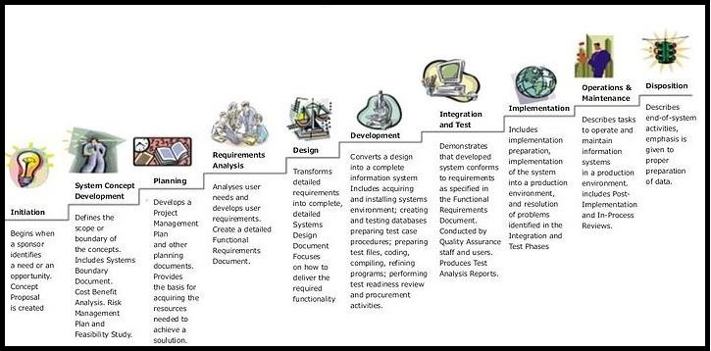
Unit Testing

Slide 3
Unit Testing
Testing is an essential aspect of any programming language
What is Unit Testing?
Unit testing is a development practice
The key focus of Unit Testing is improving software quality by identifying and resolving defects before they are leaked into production.
It tests behavior of a function/method by writing another piece of code.
Unit testing is a way to test each piece of your code which is called as unit.
It verify the functional behavior of each unit in response to correct and incorrect cases of input data and verify any assumptions made by the code. Unit test cases are usually written by the developer who has written that code unit.
Developers can also use test frameworks as per their programming languages or frameworks of code, to make writing and running unit tests easier.

Slide 4
Unit Testing
Why Unit Testing?
Unit tests reduce number of bugs, provide accurate documentation, and improve design. There are following reasons to choose unit testing.
Allow you to make big changes into code quickly since you know it's tests are working as expected and when you make the changes you need to write and run tests again to get it work.
Reduce the number of bugs in production code.
Help you to understand the design of the code since to write tests you need to outline all the conditions with respect to your code and what outputs you are expecting from the code.
Allow refactoring of code at any time without fear of breaking existing code. In this way it make the coding process more agile.
Ensure functional behavior of your code since all the tests have been passed.
We have two frameworks to write Unit Test cases in C#.
MS Test
NUnit

Slide 5
Type of Tests
Unit Tests: Test individual components in isolation from environment and concrete dependencies
Integration Tests: Test how concrete components work together within a given subsystem
End-to-End Tests: Test the behavior of an entire system with all parts functioning together
We have two frameworks to write Unit Test cases in C#.
MS Test
NUnit

Slide 6
Unit testing features in Visual Studio
Visual Studio allows the developers create and run unit tests. Unit test frameworks are used by the Visual Studio to do this.
MSTest is a framework that comes with Visual Studio. But NUnit, which is also another framework that is widely used. This also be configured with Visual Studio and used.
Visual Studio Test Explorer is used for unit testing.

Slide 7
NUNIT
NUnit is an evolving, open source framework designed for writing and running tests in Microsoft .NET programming languages.
NUnit, like JUnit, is an aspect of test-driven development (TDD),is an open source product.
NUnit has a graphical user interface (GUI) similar to that used in JUnit. Tests can be run continuously. Results are provided immediately. Multiple tests can be run concurrently.
It is written in C#.
It uses an Attribute based programming model.

Slide 8
NUNIT Attributes
TestFixture
The class that is to be tested using Nunit should be decorated with TextFixture.
Test
This attribute identifies the method to be tested. If we do not write this attribute then we can't to identify the test in Testexplorer. We have an Assert class with the following methods for validating different conditions in the TestFixture.
SetUp
This attribute is used when you want to execute a piece of code in each test case. It identifies a method to be executed each time before a TestMethod/Test is executed. Or
Identifies a method to be executed each time before a TestMethod/Test is executed
TearDown
After completely executing each test if you want to execute a piece of code then you have to write this code under TearDown attribute. Or
Identifies a method to be executed each time after a TestMethod/Test has executed
Is not executed if a test fails, of if it throws an exception
Ignore
Marks a test method or a test class which (temporarily) should not be executed

Slide 9
NUNIT
Assertions are the way to test for fail-pass test.
NUnit framework support following assertions:
Assert.
AreEquals()
AreNotNull()
AreNull()
AreSame()
GreaterOrEqual()
Fail()

Slide 10
NUNIT
You can use as many Assert statements in a method as you like.
However, NUnit framework, will show a method as failed if even a single assertion fails, as expected.
But what is important to remember is that if first assertion fails, next assertion will not be evaluated, hence you will have no knowledge about next assertion.
Therefore it is recommended that there should only be one Assertion statement per test method. If you believe there should be more than one statement, create a separate test case method.

Slide 11
NUNIT
The Naming Convention and Standards
As discussed above all test cases should go in a separate assembly. A suggested name for such assembly is [CodeAssembly].UnitTests.dll e.g. UnitTestApplication.UnitTests.dll
You should follow the naming rule defined in .NET Framework SDK. A good tool to use is FxCop to force the naming convention.
This assembly should have at minimum one-to-one relation between methods and test methods.
Test case name should be Test_[MethodToBeTested][SomeAttribute] e.g. Test_Add, Test_AddFailure.

Slide 12
Mocking
What is mocking?
Let's think that one application is being develop and many developers are working in this project and each one is assign to develop a function. Let's think that I am developing a function that will insert one employee information into the DB; if it is not present in the DB then fine and one of my fellow developer is developing the function to check the existence.
And I have completed my function but this guy has not, as he has a little bit of a workload, haha.. Now, as I completed my task, I wanted to test my function but for that I need to depend on the checking function that is still not developed.
So, how I will do that? I need to create mock object that will bypass the checking function. The point to make here is that there are many mocking frameworks to implement the mock object. In this article we will use MOQ as a mocking framework.
There are several mocking frameworks to be used in testing environments such as NMock, RhinoMocks, FakeItEasy and Moq to isolate units to be tested from the underlying dependencies

Slide 13
Moq
Moq is a powerful, extremely flexible mocking framework. When used in conjunction with NUnit, you have all the tools you need to write fast, useful unit tests that can improve the reliability of your code.
Moq is the only mocking library for .NET developed from scratch to take full advantage of .NET 3.5 (i.e. Linq expression trees) and C# 3.0 features (i.e. lambda expressions) that make it the most productive, type-safe and refactoring-friendly mocking library available. And it supports mocking interfaces as well as classes. Its API is extremely simple and straightforward, and doesn’t require any prior knowledge or experience with mocking concepts.
Getting Moq
Install-Package Moq

